Slide 1
Sitecore OrderCloud Certification SITECORE USER GROUP Coimbatore Feb 24, 2024

Slide 2
Disclaimer
The Sitecore eLearning is the original source of truth. Go through the topics and links there. This material is supplementary to that guide.

Slide 3
About OrderCloud Developer Certification Exam

Slide 4
Exam Details
As with anything practical, passing this exam doesn’t guarantee you are an expert in this area, its just to certify that you have Order Cloud basics intact
Easier to pass and relate to concepts if you use the API marketplace portal
Original Cost of exam is $350 USD but check with your work organization if there are any partner discounts / coupon codes
Online proctored exam, can take at your place of convenience on a scheduled date and time
The day prior to exam date, go to Kryterion Web assessor site and check all prerequisites are available in your machine
Keep your desk and surroundings free of clutter and possibly move your desk to corner surrounded by walls as much
Remove any sticky notes or papers on wall or around your exam desk
Need a web cam that can be moved to the side to show your hands, eyes and keyboard
No external disturbance during exam like answering doorbells or phone calls

Slide 5
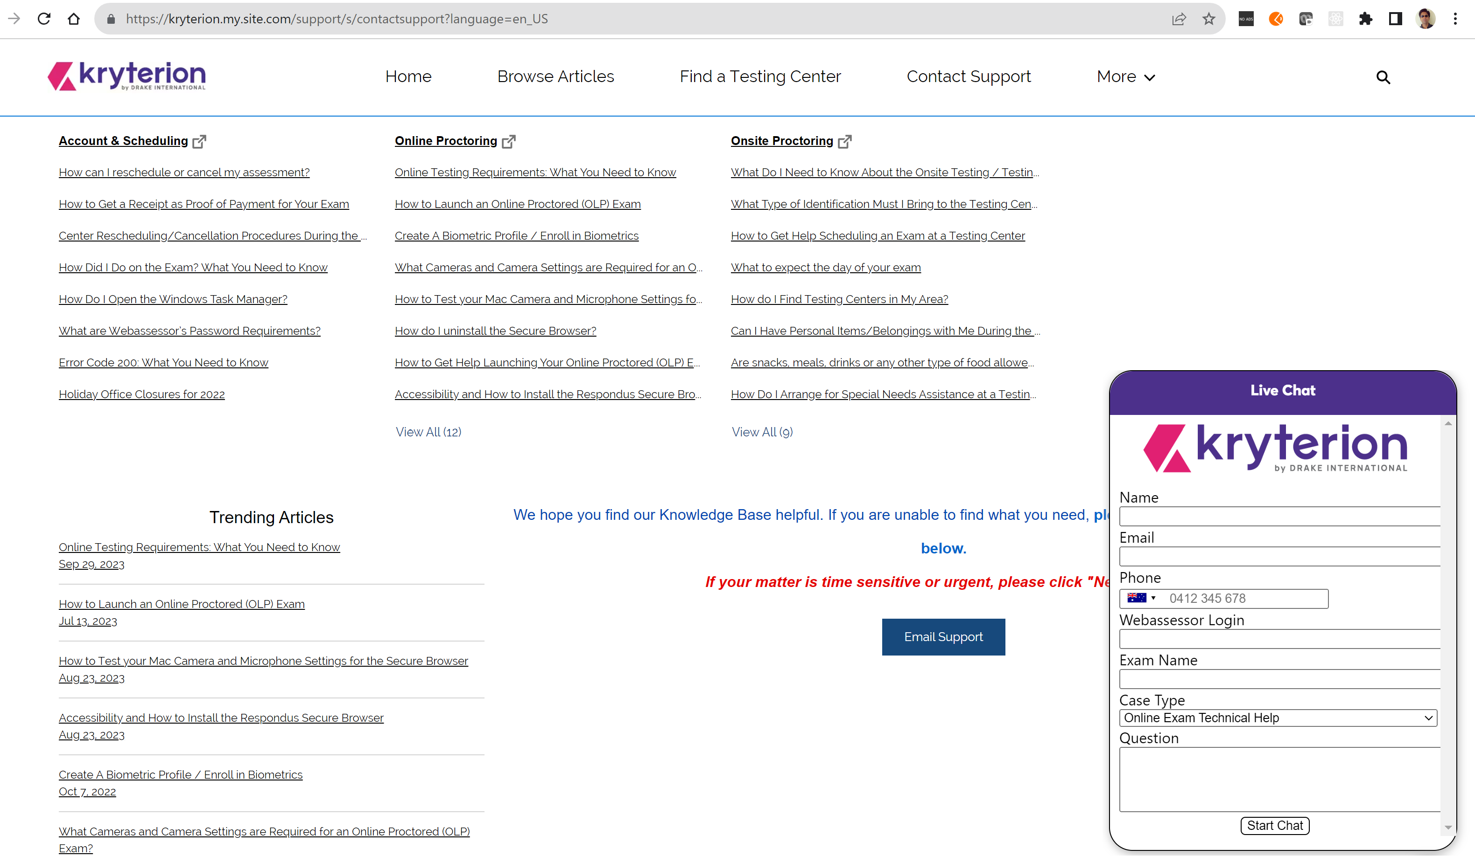
Exam Details
On the exam date, be 15 minutes earlier than the scheduled time, you can anyway start the exam only when launch button is visible in the Kryterion assessor page
At any point or time in the exam, you can be intervened by the invigilator and exam will be paused during that time
Kryterion helpline number: In Kryterion Contact Support page, click “Need Help?” button in the right bottom corner and there you can select your country and find Kryterion support phone number:

Slide 6
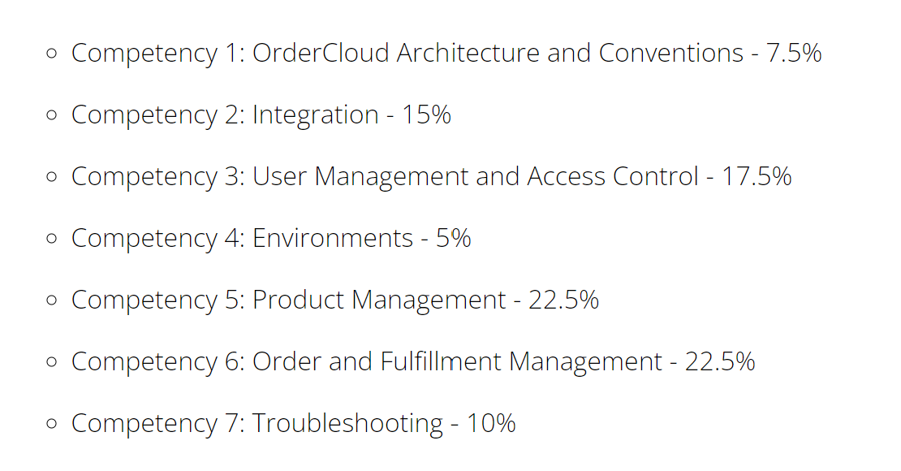
Exam Competencies

Slide 7
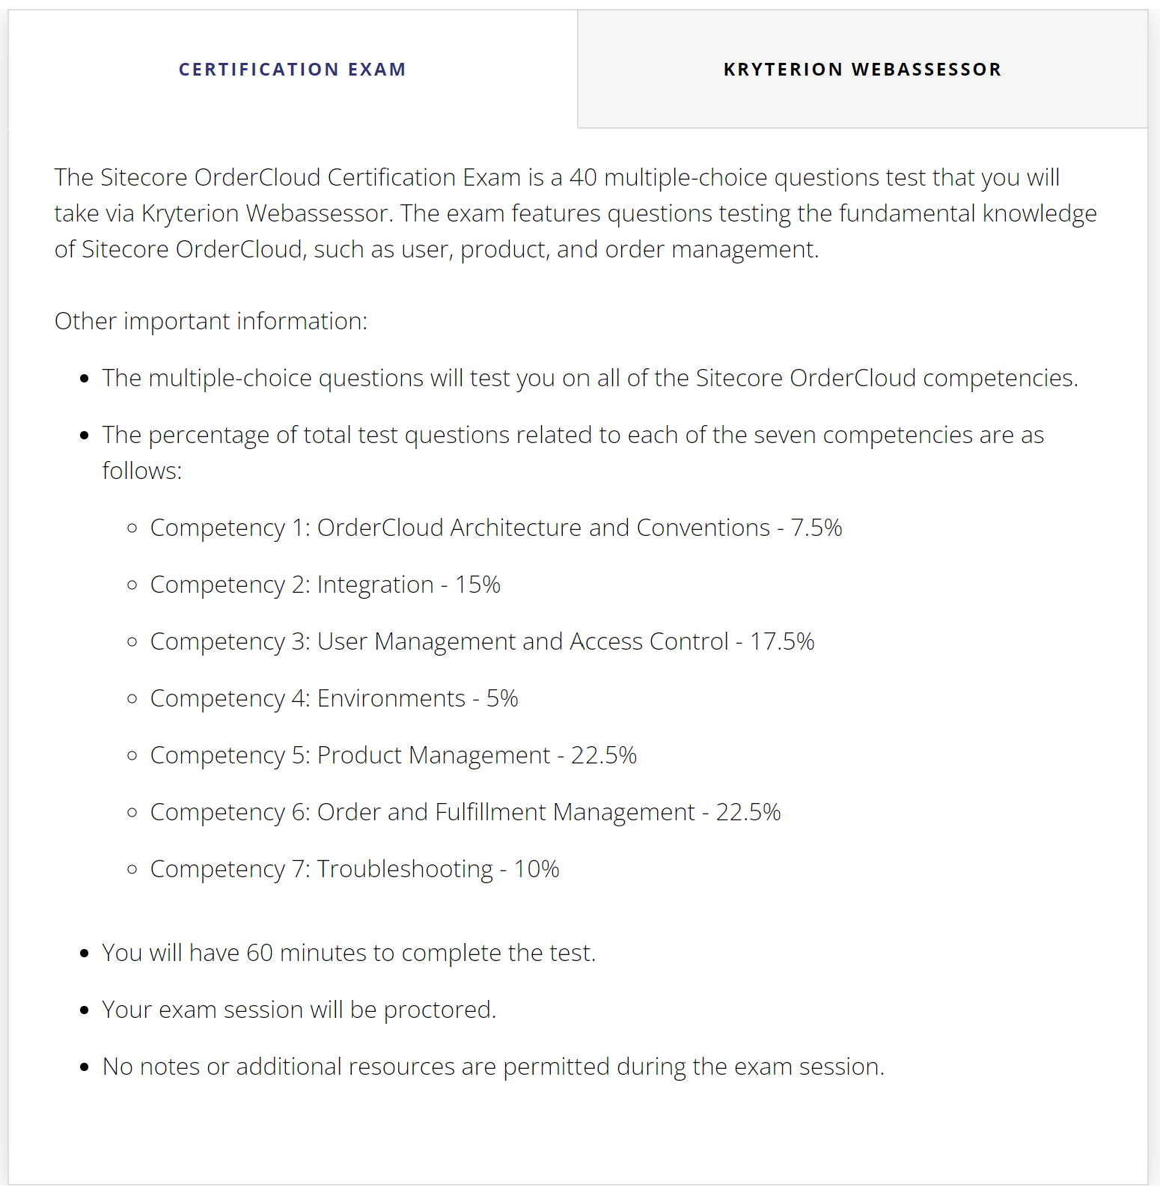
Exam Question Split-up
Competency | No. of questions
1 | 3
2 | 6
3 | 7
4 | 2
5 | 9
6 | 9
7 | 4
Total | 40

Slide 8
Competency 1
OrderCloud Architecture and Conventions

Slide 9
What is OrderCloud?
Sitecore OrderCloud is a cloud-based, API-first, and headless marketplace development platform.
API-First
RESTful APIs
Language Agnostic
Headless Architecture
Microservices
SSL Support
Multiple SDK Support
JSON-over-Http
OAuth 2 Specification
Open API 3.0 Specification
MACH Architecture: Microservices, API-First, Cloud-native, Headless

Slide 10

Third-party integration
OrderCloud
ERP
Shopper

Slide 11
Platform extensibility
Post-hook
Web Hooks
Pre-hook
Integration Events
Use OrderCloud catalyst to create strongly-typed webhooks

Slide 12

Me Endpoints
Administration
Impersonation
Me
Personalization

Slide 13
Me and My Stuff Entities
Me
My Sellers
My Cost Centers
My Addresses
My Credit Cards
My Categories
My Products
My Orders
My Promotions
My Spending Accounts
My Shipments
My Catalogs

Slide 14
Building Blocks
Supplier
Seller
Buyer
Catalog
User

Slide 15








OrderCloud Basics
Me and My Stuff
Order and Fulfillment
Marketplace
Supplier
Buyer
Seller
Authentication and Authorization
Product
Catalog

Slide 16
OrderCloud Basics
Seller
Buyer
Supplier
User
A user can be attached to buyer, seller or supplier setup

Slide 17
Commerce Strategies
B2B Marketplaces
Retail / Franchise
Direct to Consumer
Order Cloud

Slide 18
Commerce Strategies
A client has an OrderCloud Marketplace that has been used exclusively for B2B sales. Now the company’s marketing strategy has changed: in addition to businesses, they would like to open sales to individual customers. What statement would be TRUE for OrderCloud for this use case?
a. This is not possible with OrderCloud and a new product is required
b. Buy a separate Sitecore license to have this kind of functionality
c. Leave the business and go to Himalayas
d. It is possible to use the same marketplace and extend it for the new scenario

Slide 19
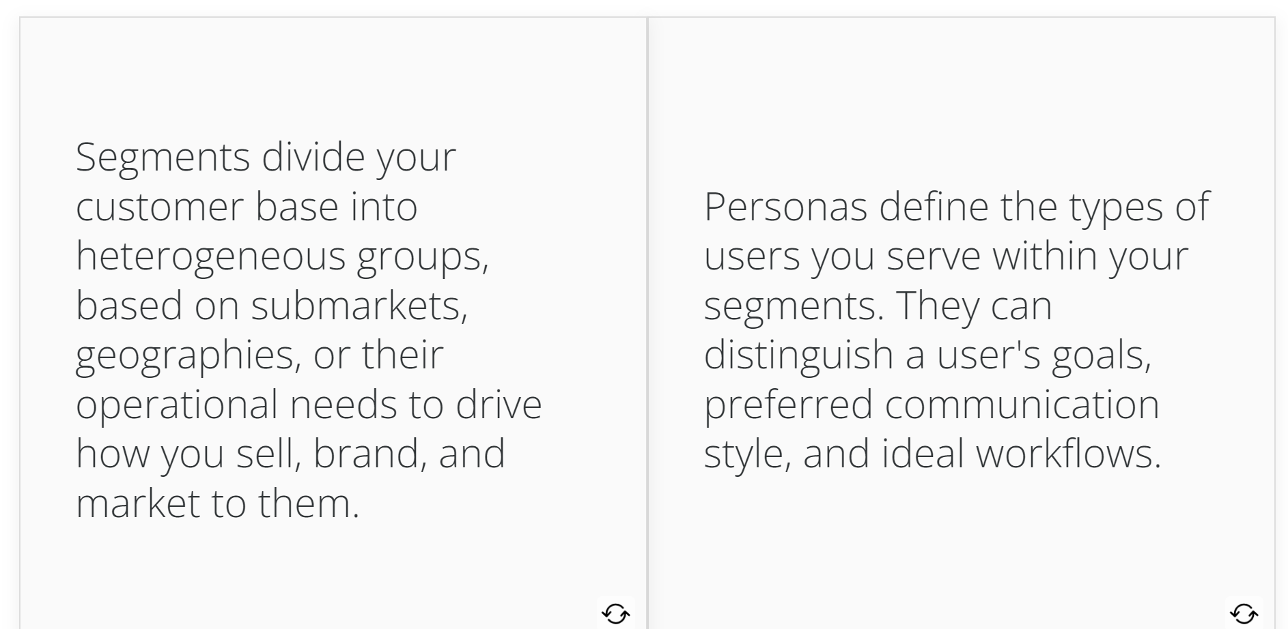
Segment and Persona
Search options, sync capabilities

Slide 20
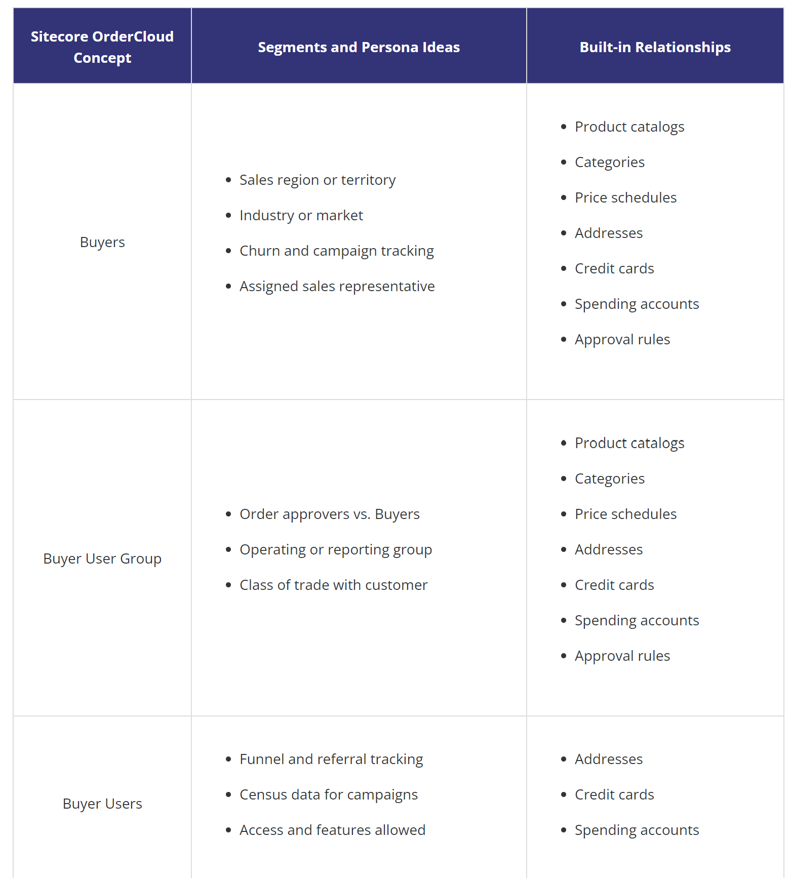
Segment and Persona
Beyonce would like to segment funnel and referral tracking for one of her market places. What Sitecore OrderCloud concept will you advise her to use?
Supplier Users
Buyer Users
Buyers
Buyer User Group

Slide 21
Important points
Variable pricing - OrderCloud supports offering different prices for the same product.
A price schedule is a price assigned to the combination of a product and a buyer or group of users.
A price break is the ability to customize pricing relative to the quantity ordered.
A price markup is the ability wherein relative to product variants and specs, you can make adjustments to the total price of the product.
Targeted promotions: rule-based promotions
Promotion redemption: E.g., Coupon code for a group of users
Get a list of addresses visible to this (Buyer) user - GET /me/addresses

Slide 22
Competency 2
Integration

Slide 23
Order Checkout Integration Event
/ShippingRates
/OrderCalculate
Order WorkSheet
/OrderSubmit
/OrderSubmitforApproval
/OrderApproved

Slide 24
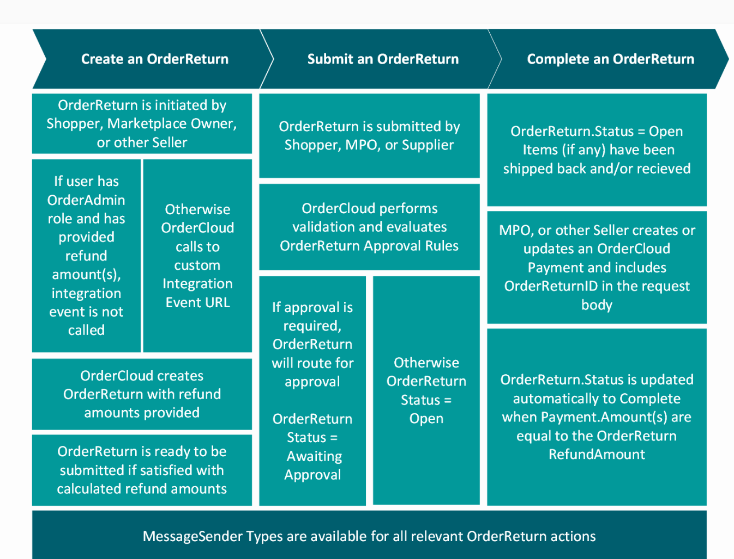
OrderReturn Integration Event type

Slide 25
Important points
Security Alert - It is considered bad practice to grant the FullAccess role to any Security Profile. Clever users with this role available to them can completely remove data essential to your OrderCloud solution by making direct API calls, even if they are not supported by your application.
It is important to note that adding a Client Secret is not necessary to enable Anonymous Shopping or Guest Checkout.
Pre-webhook response has proceed as a json boolean attribute to decide convey the external system the validation result
While defining a webhook, Secret relates to the x-oc-hash where OrderCloud will use this secret to generate a fingerprint you can validate against

Slide 26
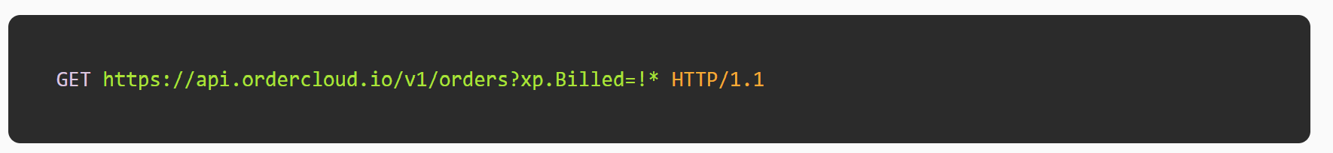
Important points
OrderCloud supports advanced querying using search keyword in url, logical operators, comparison operators, sorting using sortby keyword. Below is one such possibility:
You can use Extended Properties (XP) to store datapoints that are not already available in Sitecore OrderCloud.

Slide 27
Quiz time
In your OrderCloud Marketplace, “Color” is listed as a Extended Property (xp) field. You need to find all the products which are black or white colored. What type of query is most effective?
a. GET https://sandboxapi.ordercloud.io/v1/products?xp.Color=black|white
b. GET https://sandboxapi.ordercloud.io/v1/products?xp.Color=bl*|w*
c. GET https://sandboxapi.ordercloud.io/v1/products?xp.Color=black&xp.Color=white
d. GET https://sandboxapi.ordercloud.io/v1/products?xp.Color!=black&xp.Color!=white

Slide 28
Competency 3
User Management and Access Control

Slide 29
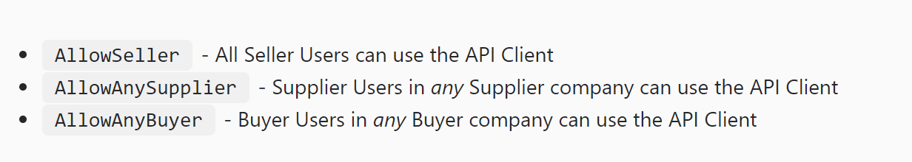
API Client User Access
OrderCloud uses the term API Clients to identify various access points to your marketplace's data. These access points have properties that control what parties can use it, how they can gain access, and for how long that access remains valid.
AllowSeller
AllowAnySupplier
AllowAnyBuyer

Slide 30
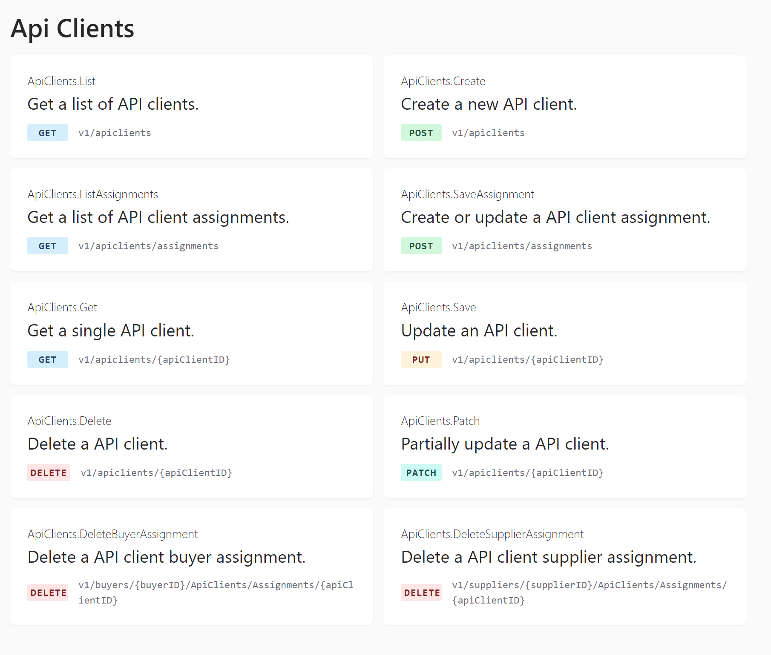
API Client End points

Slide 31
Authentication - Order Cloud Workflows
Password Grant Type
Client Credentials
Refresh
Elevated Password
SSO via OpenID Connect
Guest Checkout
ClientId
Scope
Username
Password
Grant Type
(set to password)
ClientId
Client Secret
Scope
Grant Type
(set to client_credentials)
ClientId
Refresh Token
Grant Type
(set to refresh_token)
ClientId
Scope
Username
Password
Client Secret (set on api client)
Grant Type
(set to password)
Google
Facebook

Slide 32
Token Durations
AccessTokenDuration
access_Token
RefreshTokenDuration
refresh_Token
Once a party has the appropriate level of access to your marketplace - it's important to control how long that access will last. Access token expires in duration configured for access token then based on refresh token duration, a refresh token is provisioned and this refresh token is used to acquire a new access token.

Slide 33
Important points
For elevated password flow in the authentication process, both client secret and grant type (set to password) is required.
In case of SSO via OpenID Connect, OrderCloud needs ConnectClientID and ConnectClientSecret

Slide 34
Quiz time
When logging in with /oAuth/token, a user gets Auth.SellerNotActive error code authentication error, what does that mean?
a. The MPO is inactive not accessible to login
b. User is not active, need to complete setup to activate
c. User is locked out due to exceeding the max attempts
d. One or more of the roles requested is not allowed for this user

Slide 35
Quiz time
When logging in with /oAuth/token, a user gets Auth.SellerNotActive error code authentication error, what does that mean?
a. The MPO is inactive not accessible to login
b. User is not active, need to complete setup to activate
c. User is locked out due to exceeding the max attempts
d. One or more of the roles requested is not allowed for this user

Slide 36
Competency 4
Environments

Slide 37
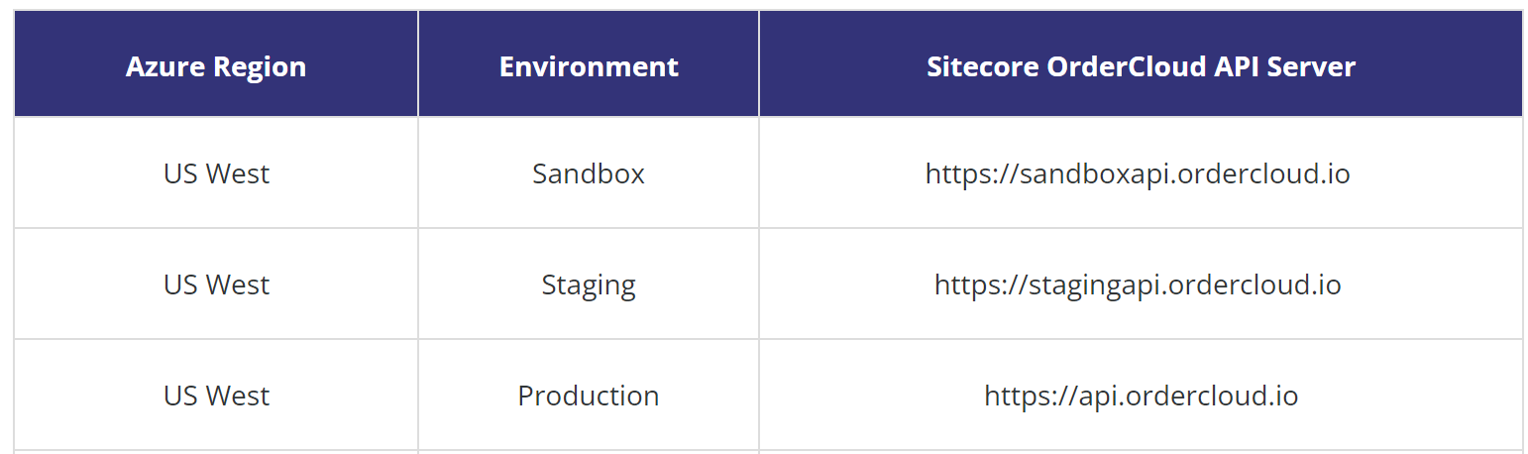
Environments
Environment | Restoration Details
Production | Not Applicable, hosts live data
Staging | Restored weekly from production
Sandbox | Never restored

Slide 38
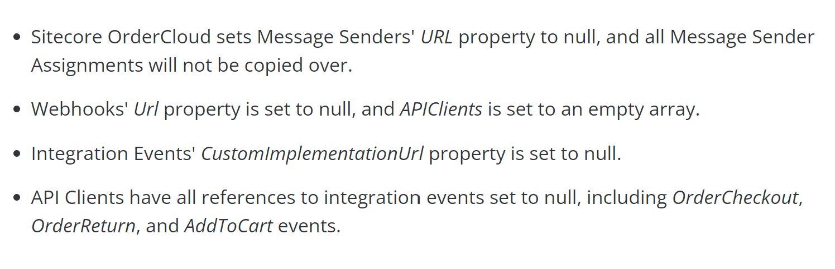
Important points
The environment and region of a market place cannot be changed after created.
Staging restore process happens on a weekly basis, during this time:
Staging restore process
Staging Post-restore Webhook

Slide 39
Quiz time
After developing a new feature for OrderCloud, you want to test it in an environment that has fake data. Which API URL should you use?
a. https://test.ordercloud.io
b. https://idontknow.ordercloud.io
c. https://sandboxapi.ordercloud.io
d. https://api.ordercloud.io

Slide 40
Competency 5
Product Management

Slide 41
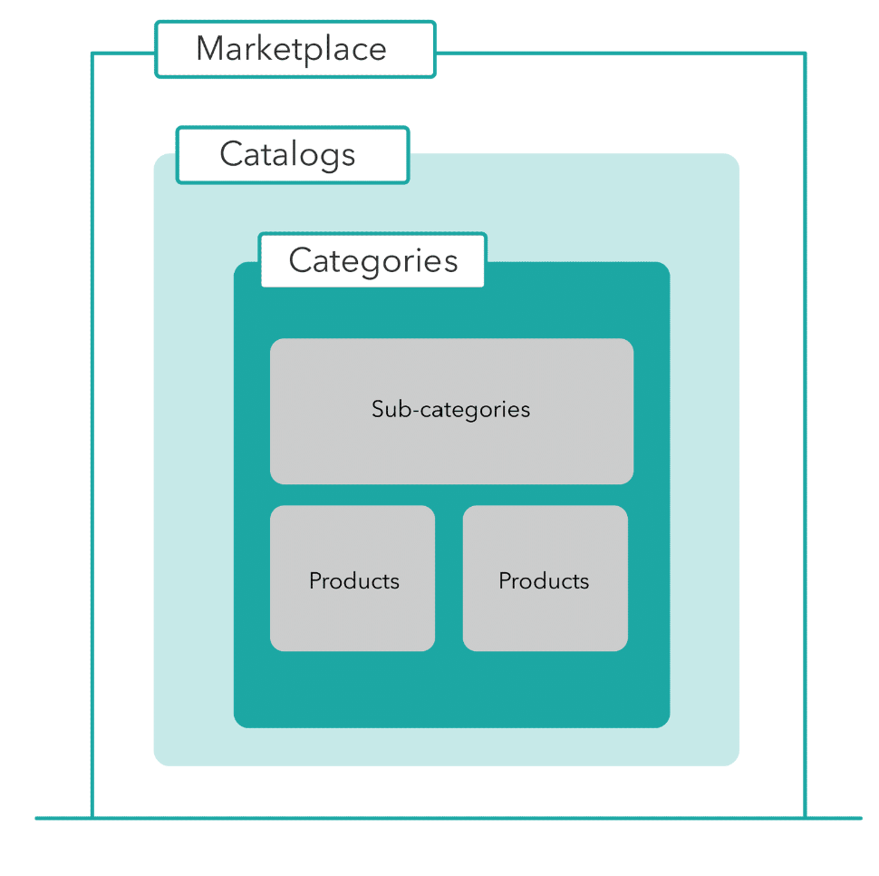
MP / Catalog / Category

Slide 42
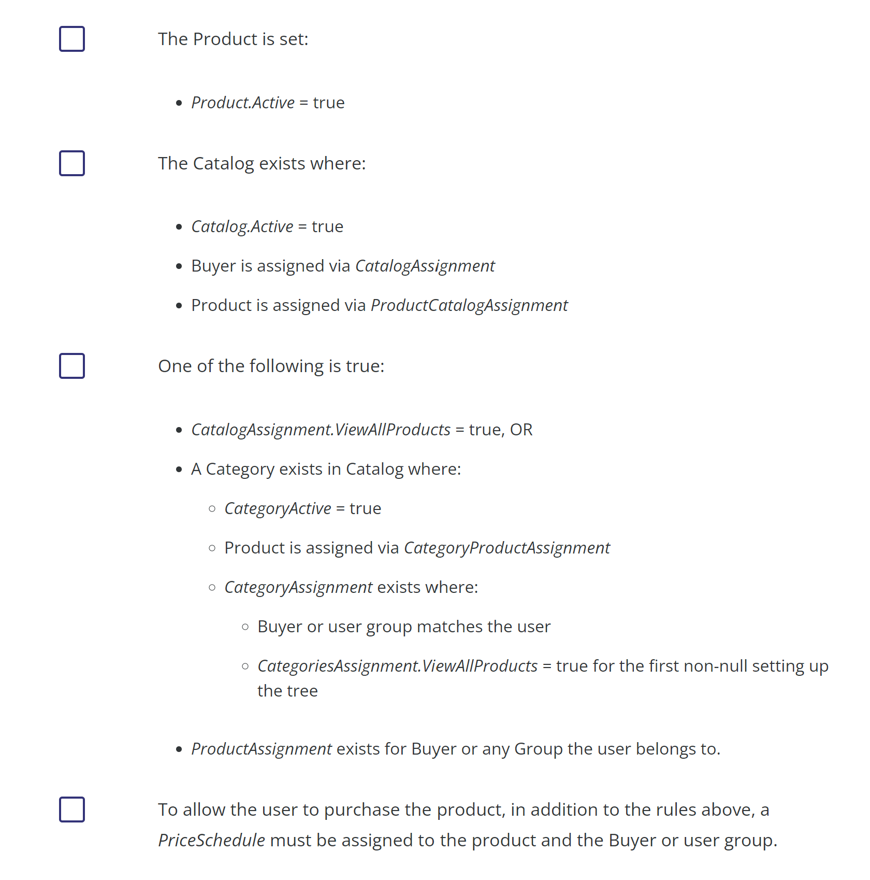





Buyer Product visibility requirements

Slide 43
Specs
Open Text Spec: Allows a user to input or type-in options E..g., personalized gifts
Options Spec: Limit the user with a set of limited options E.g., size selection
Spec Options: Options available for the options spec E.g., the actual sizes
Variant Spec: Slice a product based on each spec like, different colors for same size t-shirt

Slide 44
Important Points
Sitecore OrderCloud supports any number of catalogs within a MP
Catalog assignment helps share a catalog with any number of buyers
Businesses can offer specific products to certain customers through the assignment of catalogs
Endpoint to assign a product to a catalog - POST /catalogs/{catalogID}/productassignments/{productID}
Products can be assigned to catalog without a category
Categories help define a product hierarchy

Slide 45
Quiz time
An online shop offers shirts in 3 sizes and four colors: S, M, L and brown, black, grey, and blue. How many variants does this product have, and how can we get the full list of those variants?
a. 9 variants, GET /products/{productID}/variants
b. 10 variants, GET /products/{productID}/variants
c. 7 variants, GET /products/{productID}/variants
d. 12 variants, GET /products/{productID}/variants

Slide 46
Competency 6
Order and Fulfillment Management

Slide 47
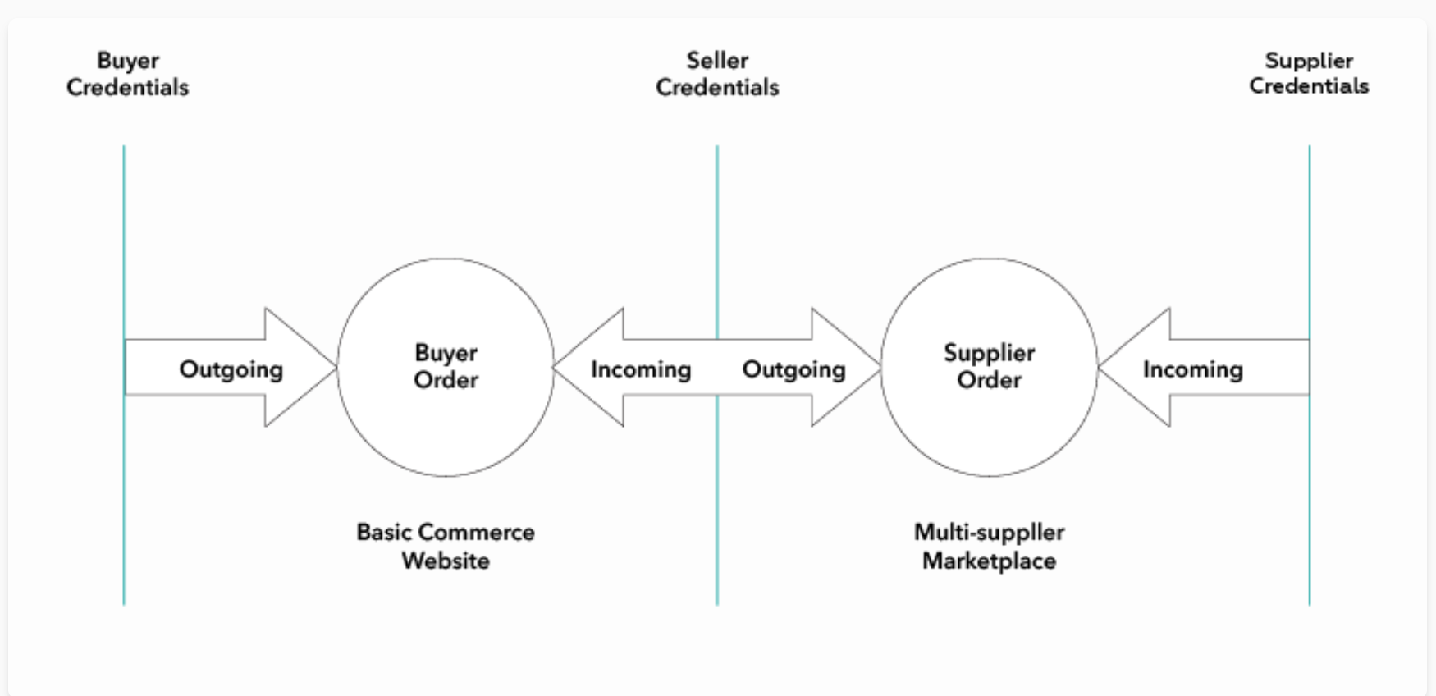
Order Direction

Slide 48
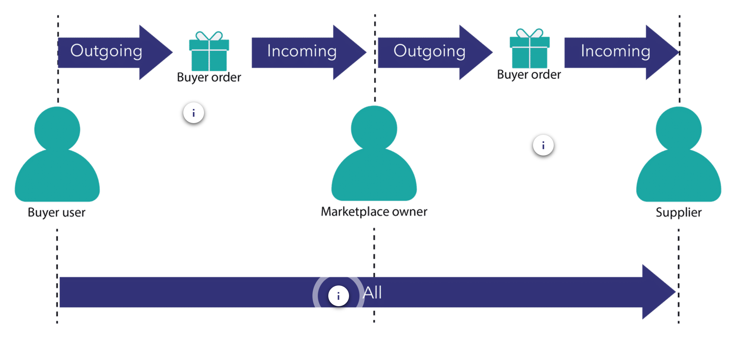
Order Direction
Remember that buyer and shopper mean the same.

Slide 49
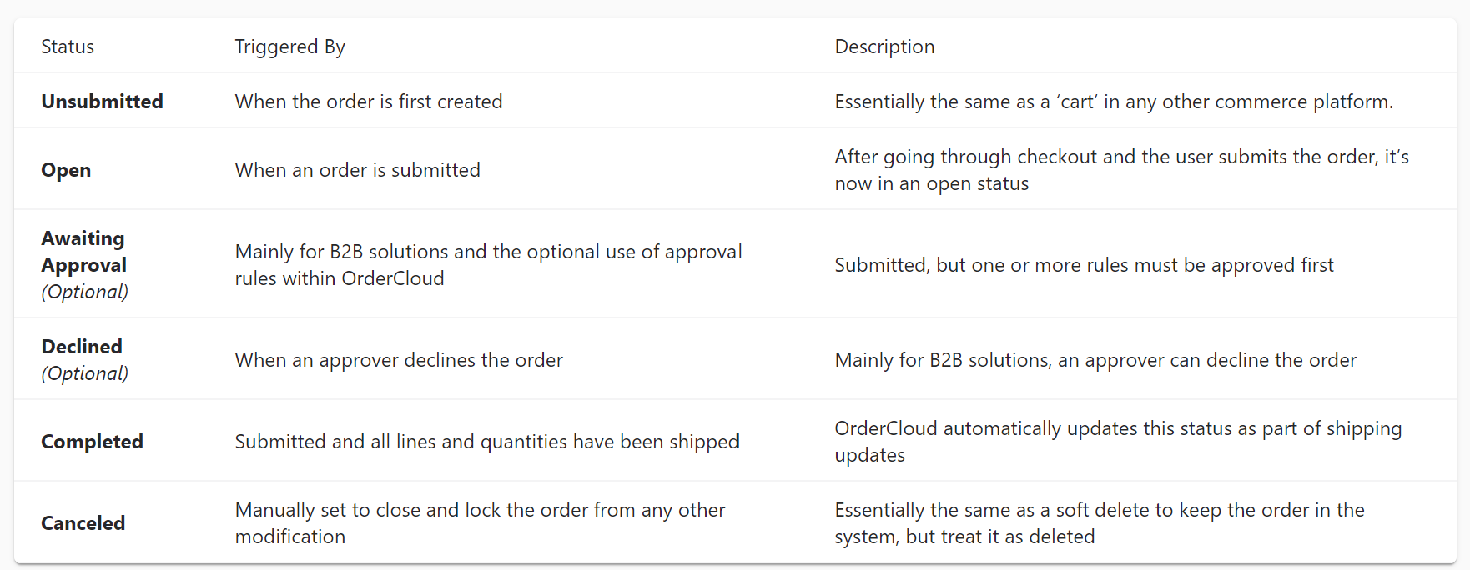
Order Statuses
Unsubmitted
Open
Awaiting Approval
Declined
Completed
Canceled

Slide 50
Different payment methods
Credit card
Purchase order
Spending Account
In OrderCloud, with an option called spending accounts, a registered customer receiving a gift card of $x can use it to pay their order of $x in full.

Slide 51
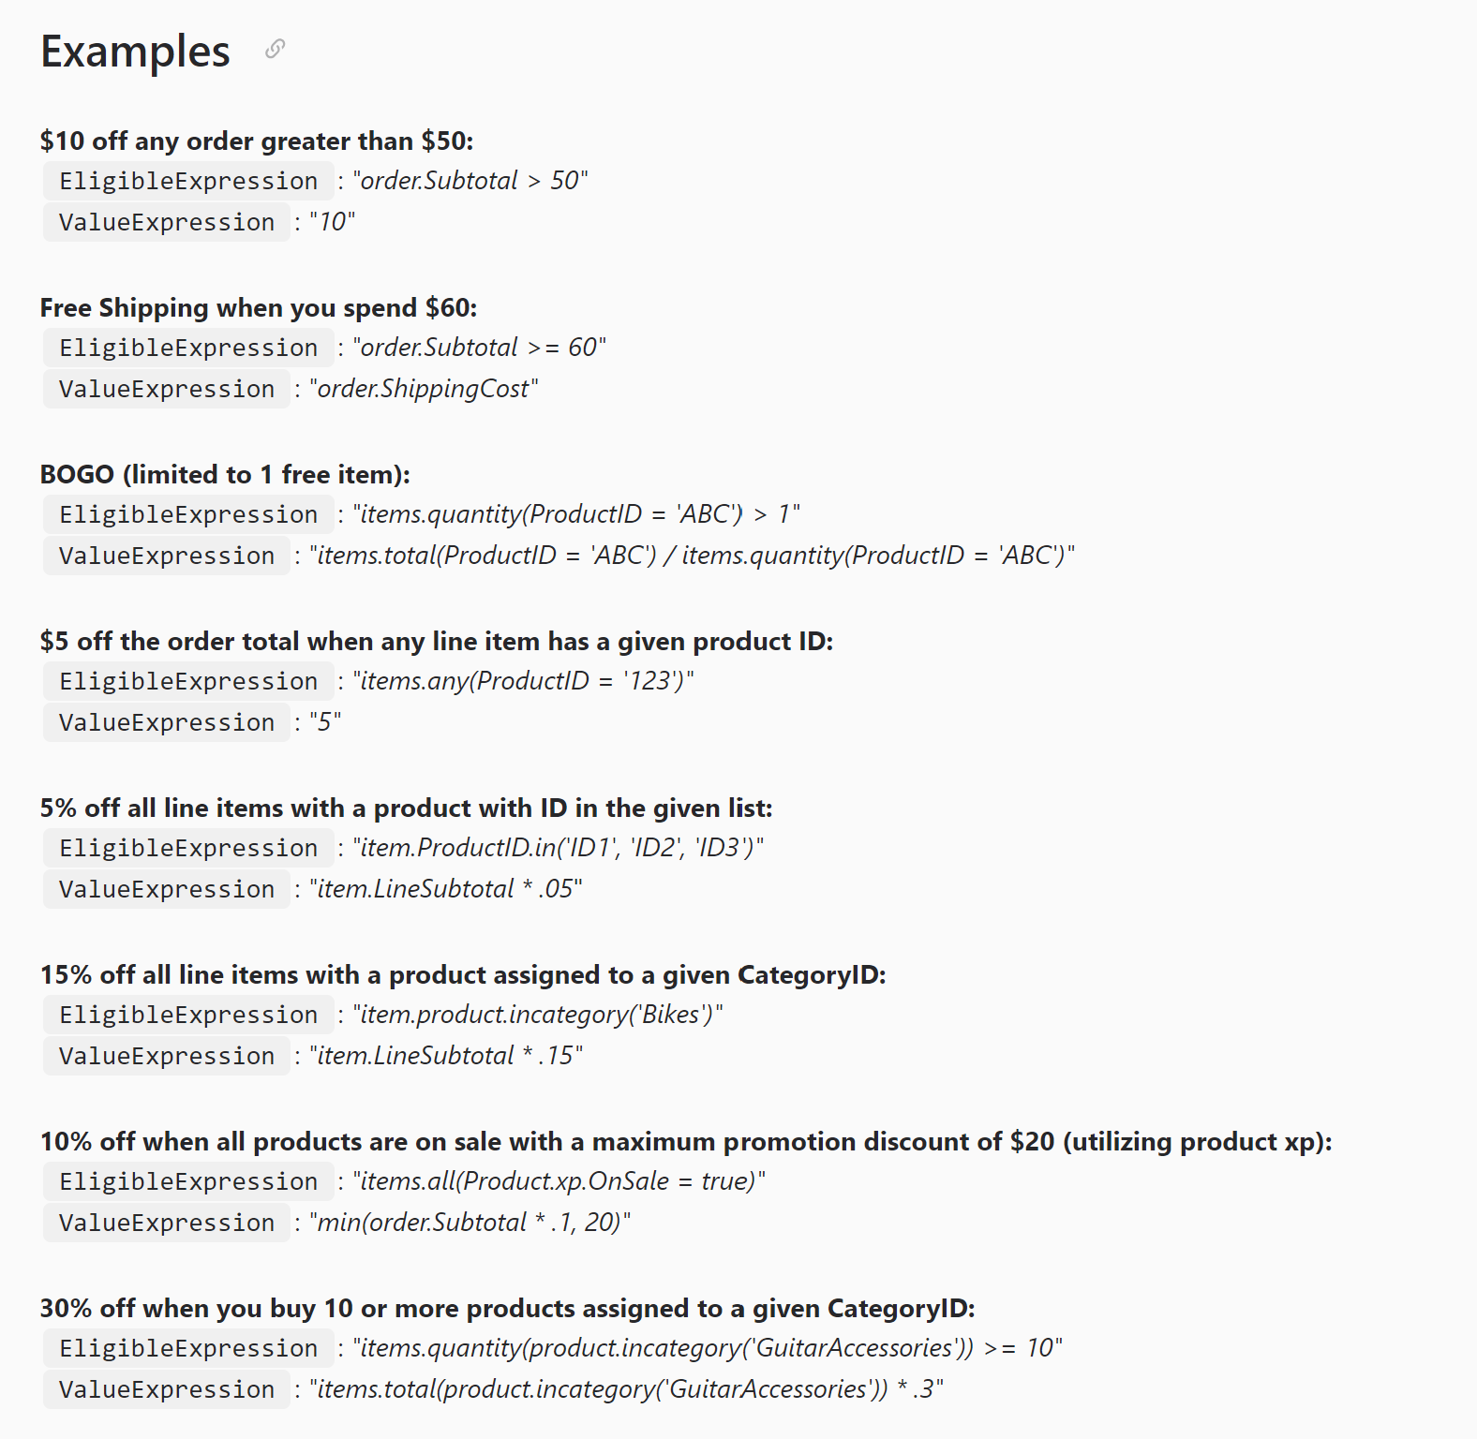
Eligible Expression vs Value Expression
Rule-based Promotion Expressions:

Slide 52
Important points
If an order is fulfilled by many suppliers, then the order will be forwarded from the Market Place owner (seller) to the concerned supplier(s) – this is called order forwarding: Buyer -> Seller -> Supplier – although the order goes via the supplier, the supplier is the one who fulfills the buyer’s order
EligibleExpression: evaluates the current state of the order and returns true or false indicating whether the promotion can be applied to the order
ValueExpression: evaluates the order and returns a monetary value, which is then subtracted from the order subtotal
Users with assigned FullAccess, OrderAdmin, or Shopper roles can create/submit/update/cancel an order

Slide 53
Quiz time
BlueStar is an online shoe retailer, and Sitecore OrderCloud powers its commerce solution. Lee made an order that contained two sneakers and one pair of socks. The retailer sent the sneakers to Lee. However, due to the high volume of orders, BlueStar had to send the pair of socks separately after two weeks. What's the status of the order after Lee received the socks?
a. Unsubmitted
b. Submitted
c. Open
d. Completed

Slide 54
Quiz time
A shopper made an order on a bouquet website. The order number is OEF7438. The buyer can access the order by calling ____________. (Select all that apply.)
a. GET /orders/incoming/OEF7438
b. GET /orders/outgoing/OEF7438
c. GET /orders/all/OEF7438
d. GET /orders/outgoing/OEF7438/lineitems/7438

Slide 55
Competency 7
Troubleshooting

Slide 56
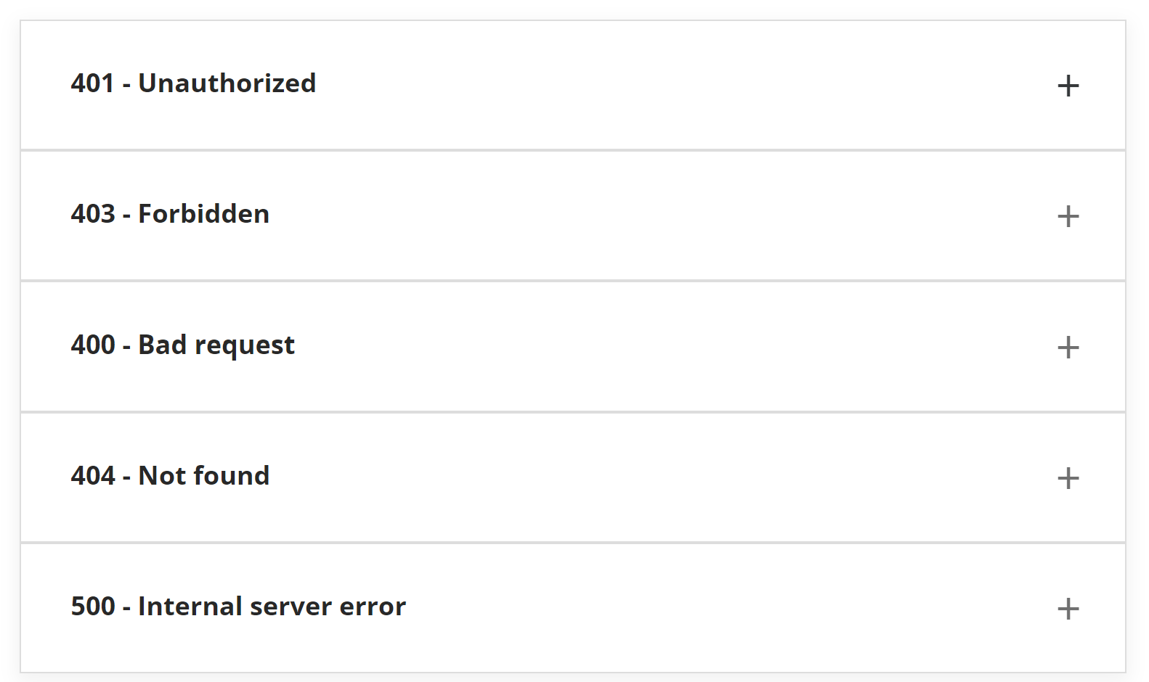

Unsuccessful Http Status Codes

Slide 57
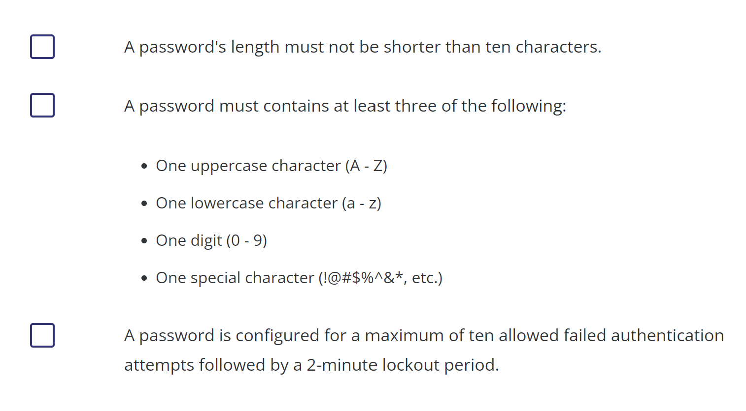
Minimum Password requirements

Slide 58
Important points
PasswordConfig object within a security profile is useful to setup password rules
For buyer user to view and purchase product, the following assignments are necessary: Product catalog assignment, Catalog buyer assignment and Price schedule assignments
PUT vs Patch Http verbs: Former creates or replaces an item with unique id but latter updates the item

Slide 59
Quiz time
While using the /password/reset endpoint, what does the errorcode PasswordReset.InvalidVerification mean?
a. Password reset attempt with expired token
b. User will need to wait until retrying again
c. Credit card information is wrong
d. The user is dead
https://ordercloud.io/knowledge-base/authentication

Slide 60
References
https://ordercloud.io/

